Slide 1

Enterprise Software Development

Slide 2
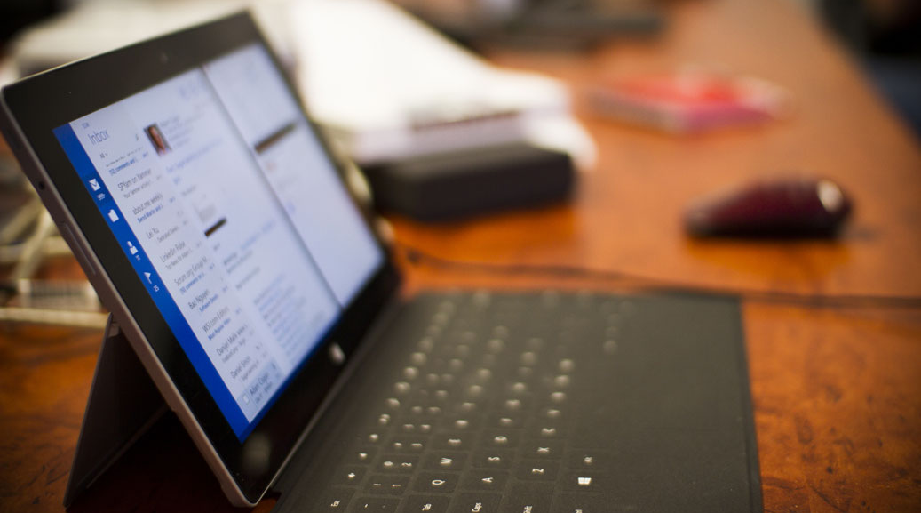
Getting started with Cognitive Services
AI Hack Day 2022
V2

Slide 3








Jernej Kavka (JK)
SSW Solution Architect
@Jernej_kavka
github.com/jernejk
jkdev.me
linkedin.com/in/jernejkavka/
Organizer of AI events
.NET Core and EF Core dev specialist
Cognitive Services and ML․NET enthusiast🦸‍♂️

Slide 4

Table of Contents
Cognitive Services
Get started
Demos

Slide 5
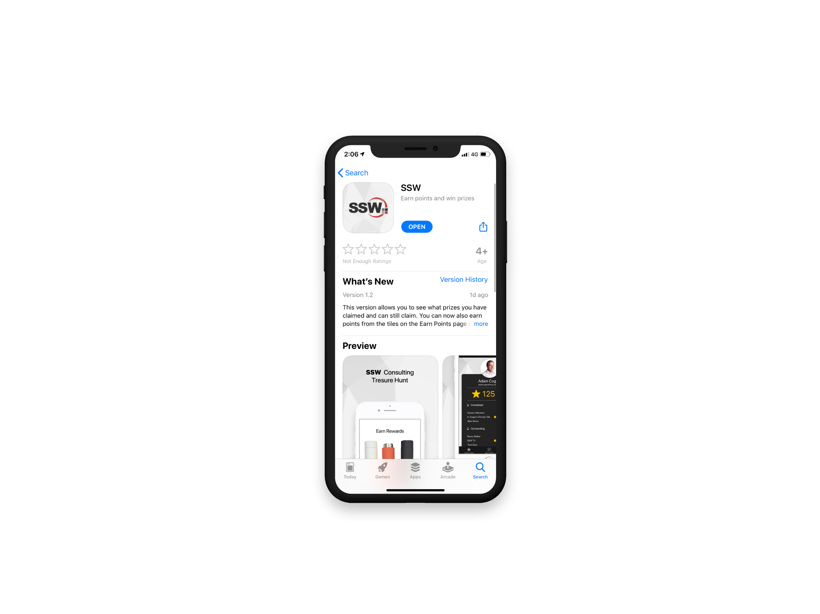

Scan QR Code to install app
Scan SSW codes at talks and events
Earn SSW Points
claim rewards, and win prizes
SSW Rewards
Notes:
An SSW Admin will give you your QR code https://my.sugarlearning.com/SSW/items/13946/ssw-rewards-setup-the-ssw-rewards-app

Slide 6


Agenda
Get started
Cognitive Services
Facial recognition demo

Slide 7
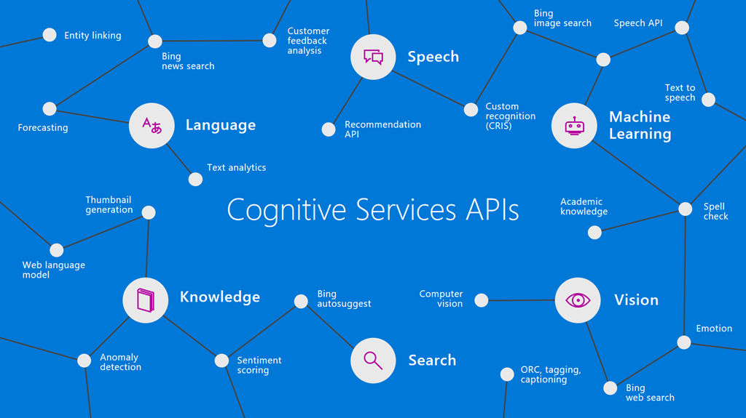

Slide 8
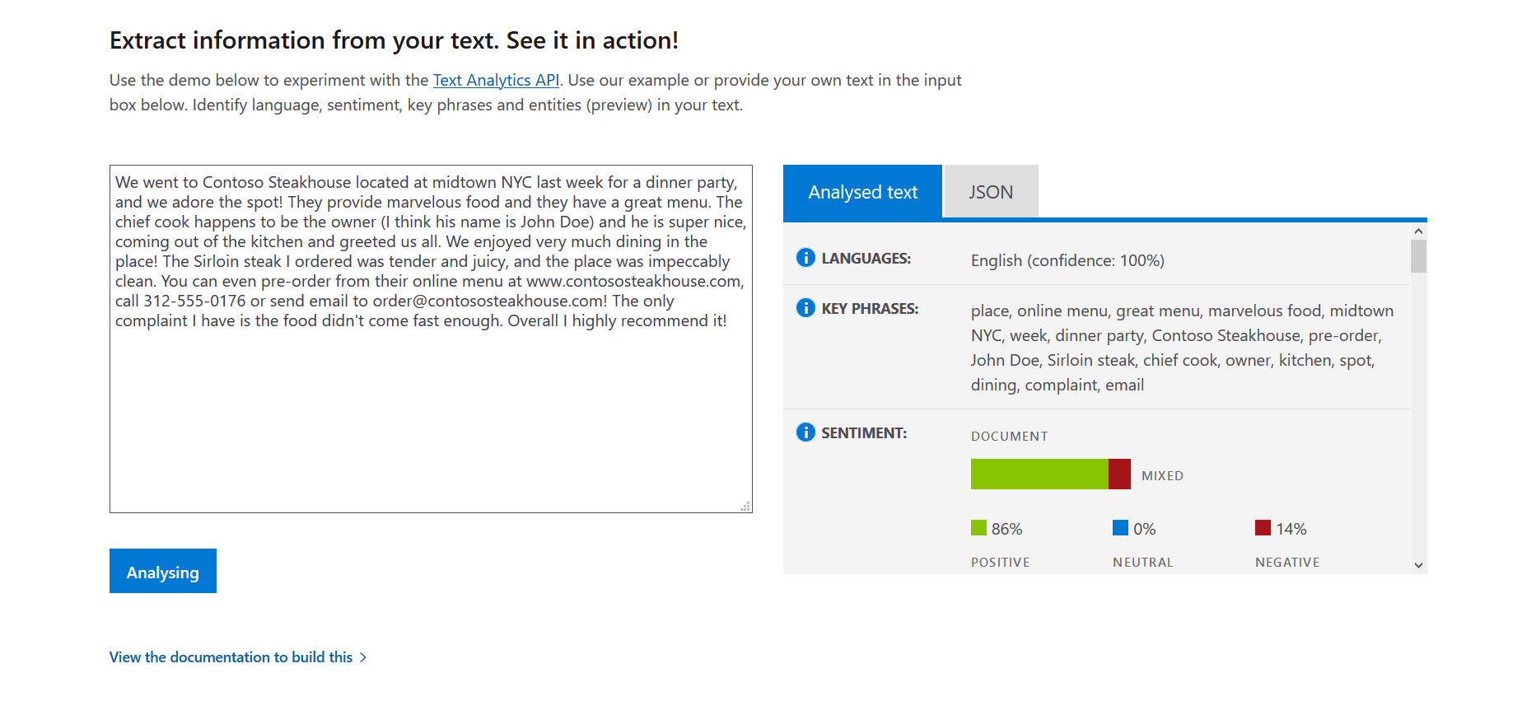

Slide 9
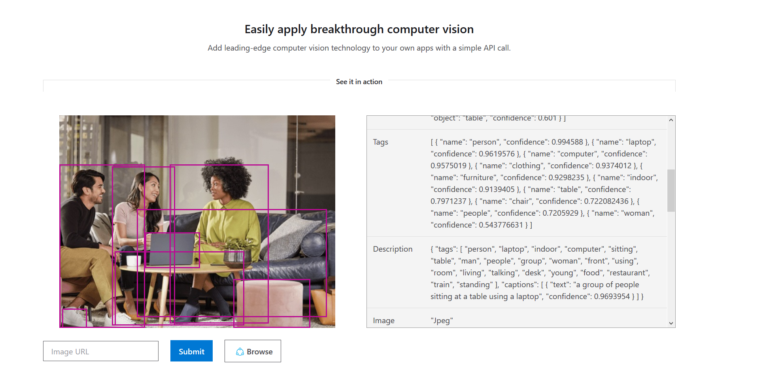

Slide 10
Table of Contents
Cognitive Services
Get started
Demos

Slide 11
Agenda
Get started
Cognitive Services
Facial recognition demo

Slide 12
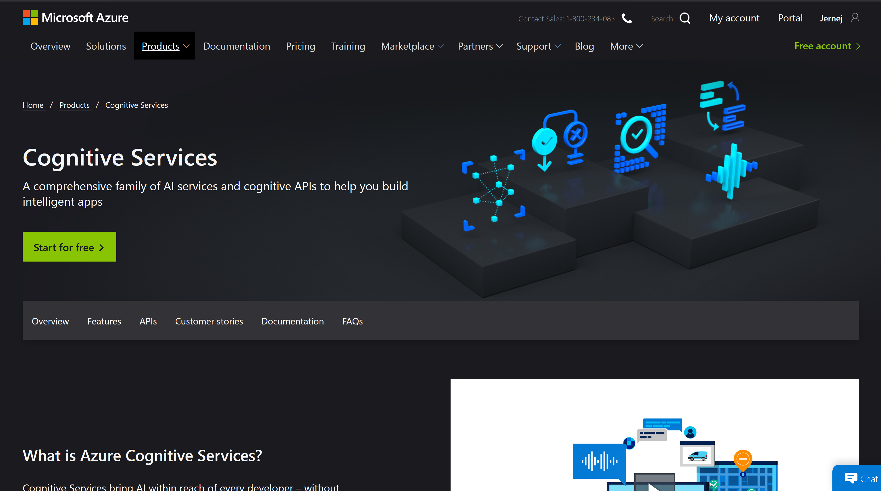
https://azure.microsoft.com/en-au/services/cognitive-services/

Slide 13
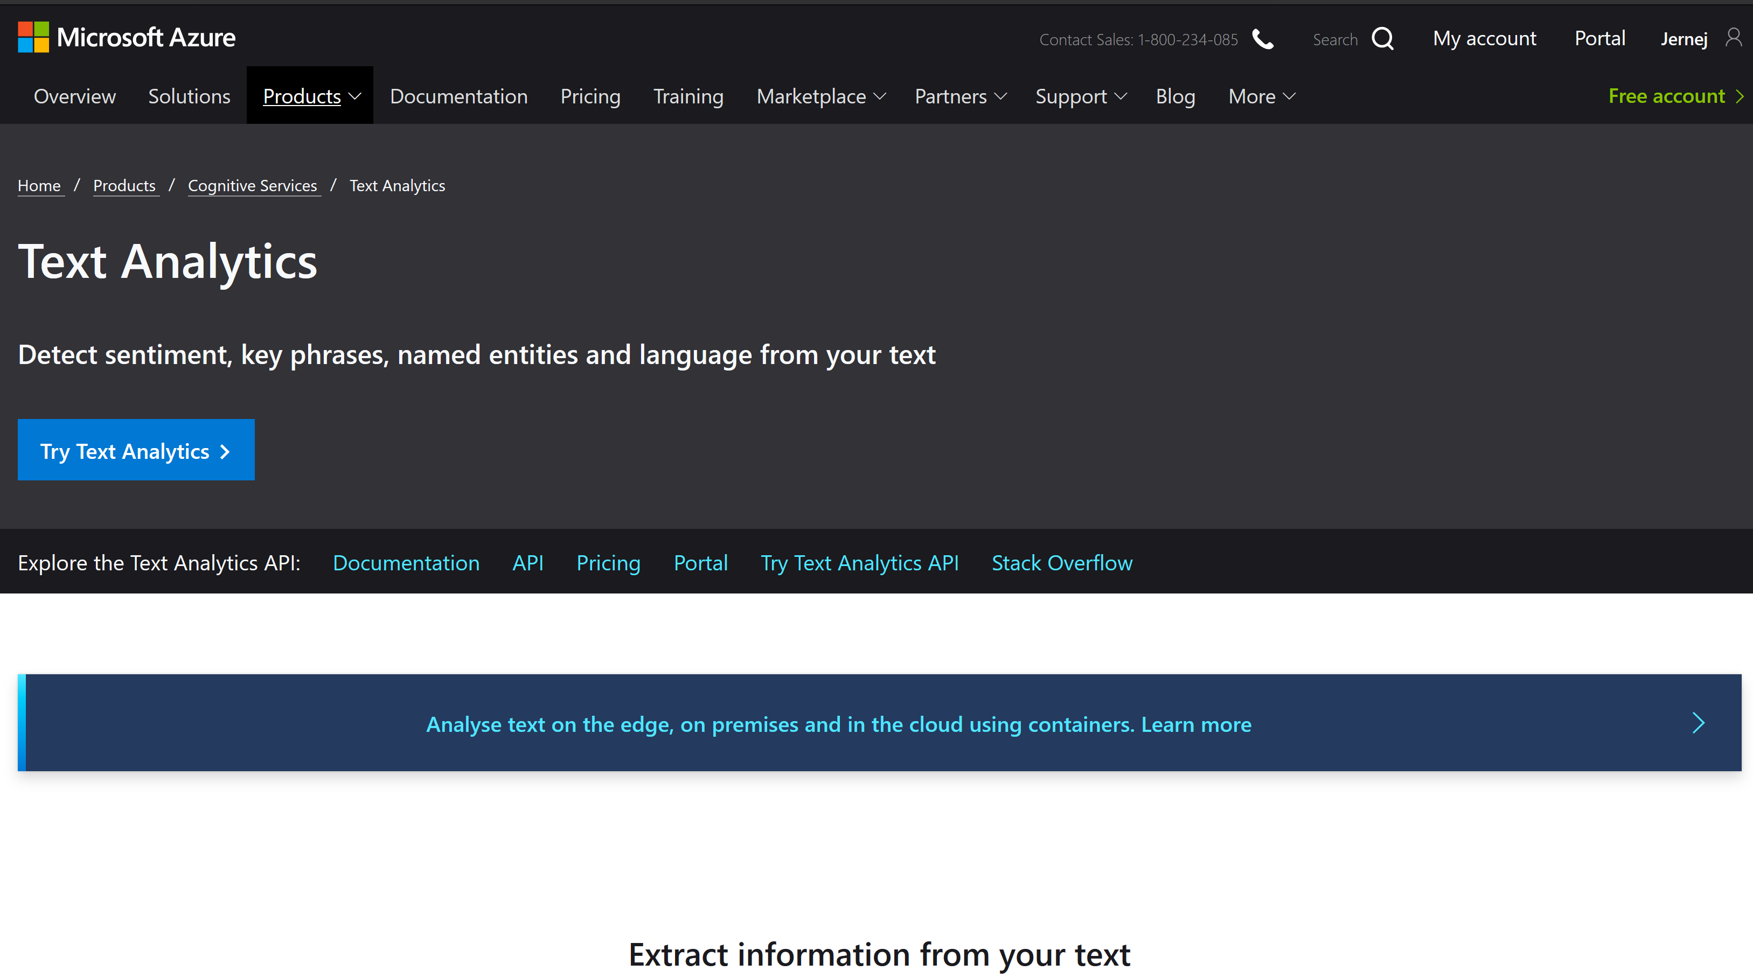
https://azure.microsoft.com/en-au/services/cognitive-services/text-analytics/

Slide 14
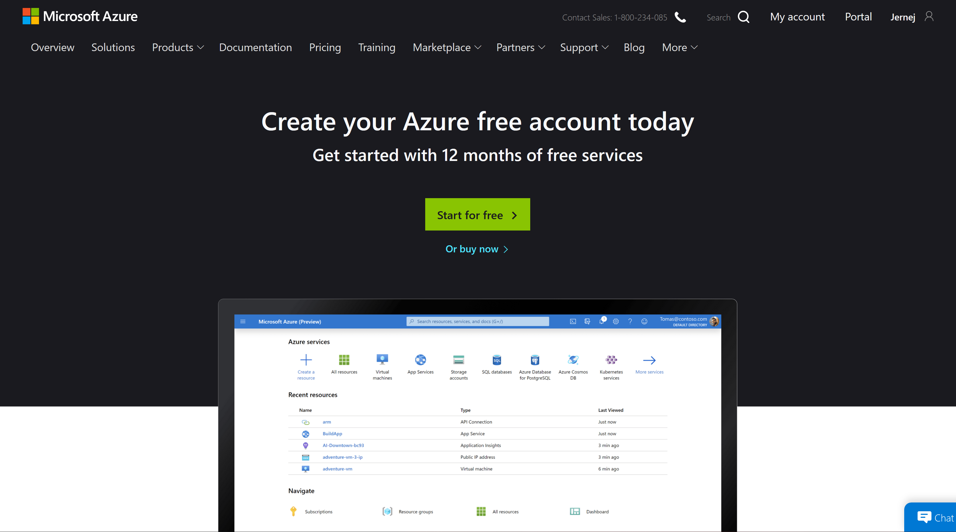
https://azure.microsoft.com/en-au/free/

Slide 15
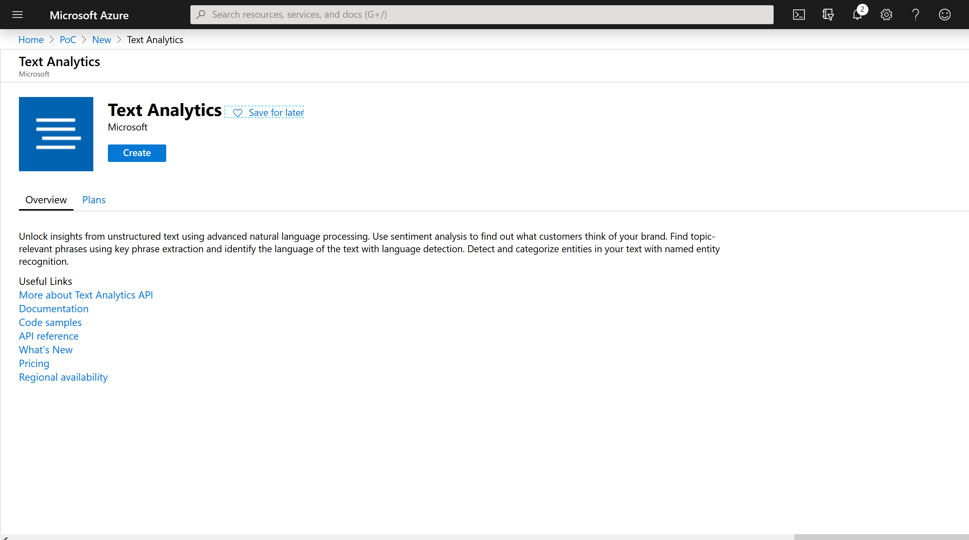
https://portal.azure.com

Slide 16
PowerShell – Create TextAnalytics
az cognitiveservices account create --kind TextAnalytics --location EastUS --name text-api-name --resource-group resource-group-name --sku F0 --yes
az cognitiveservices account keys list --name text-api-name --resource-group resource-group-name

Slide 17
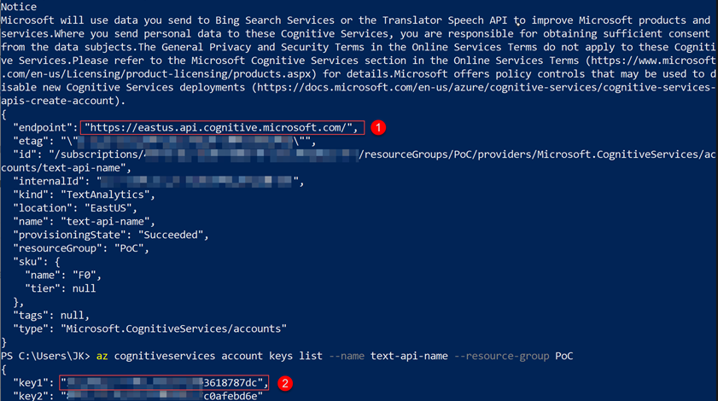

Slide 18
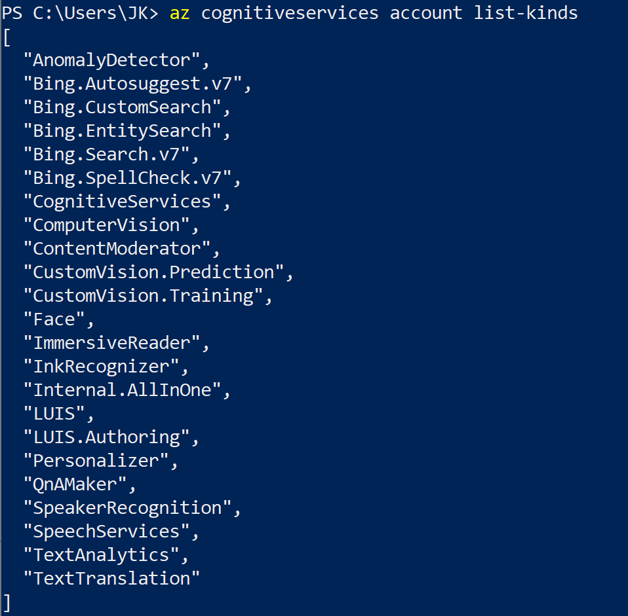
PowerShell – list all services
az cognitiveservices account list-kinds

Slide 19
Table of Contents
Cognitive Services
Get started
Demos

Slide 20
Agenda
Get started
Cognitive Services
Facial recognition demo

Slide 21
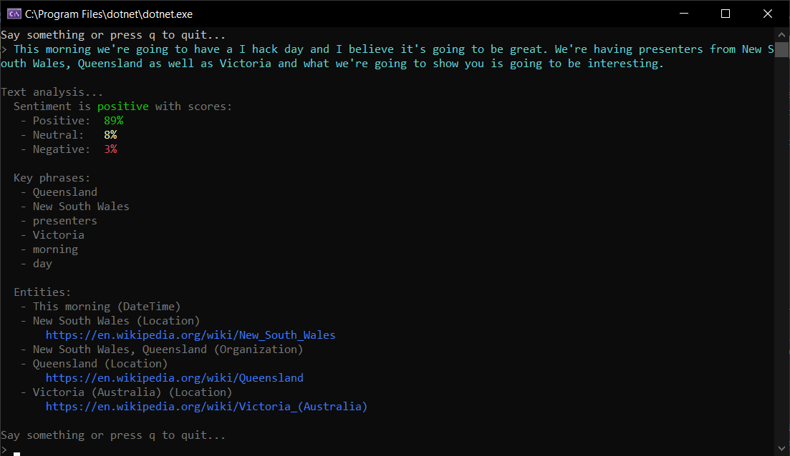
Call center demo - github.com/jernejk/CognitiveServicesDemo.CustomerSupport

Slide 22
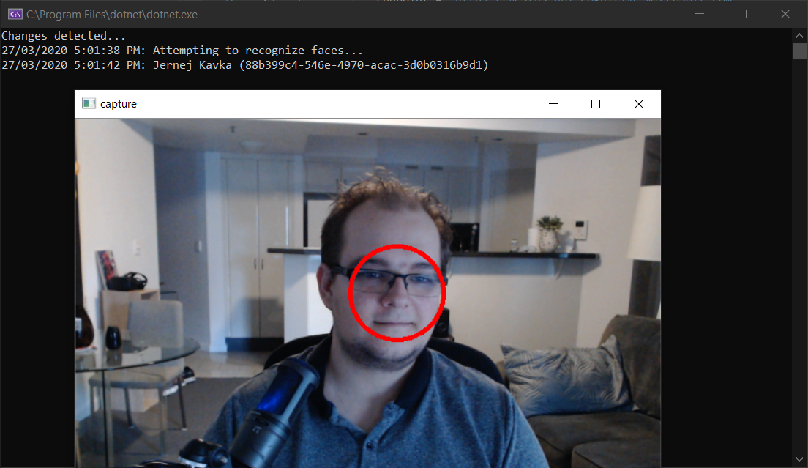
Facial recognition demo - github.com/jernejk/RealTimeFaceApi

Slide 23
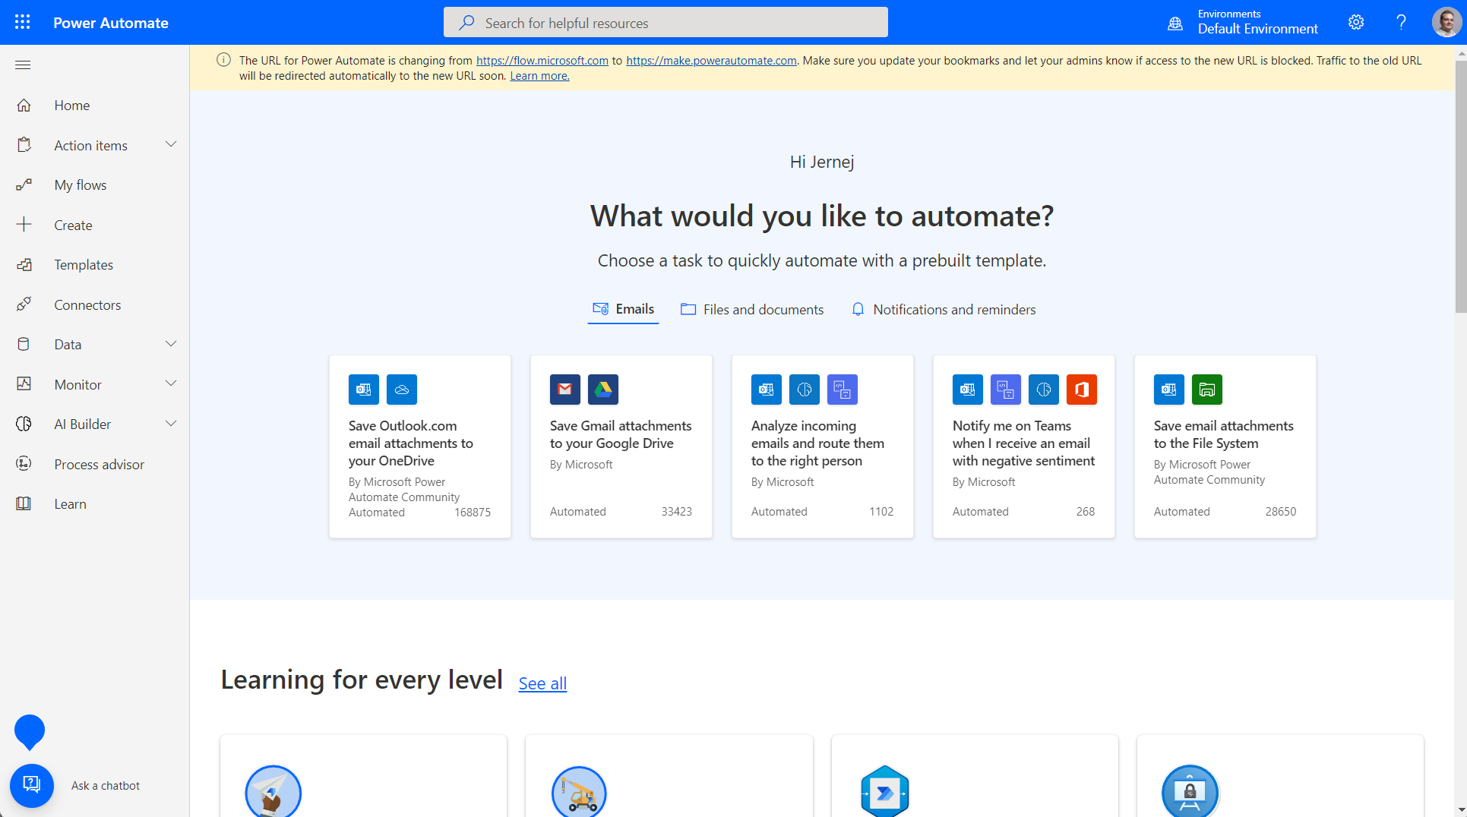
Power Automate Web - australia.flow.microsoft.com/en-us/

Slide 24
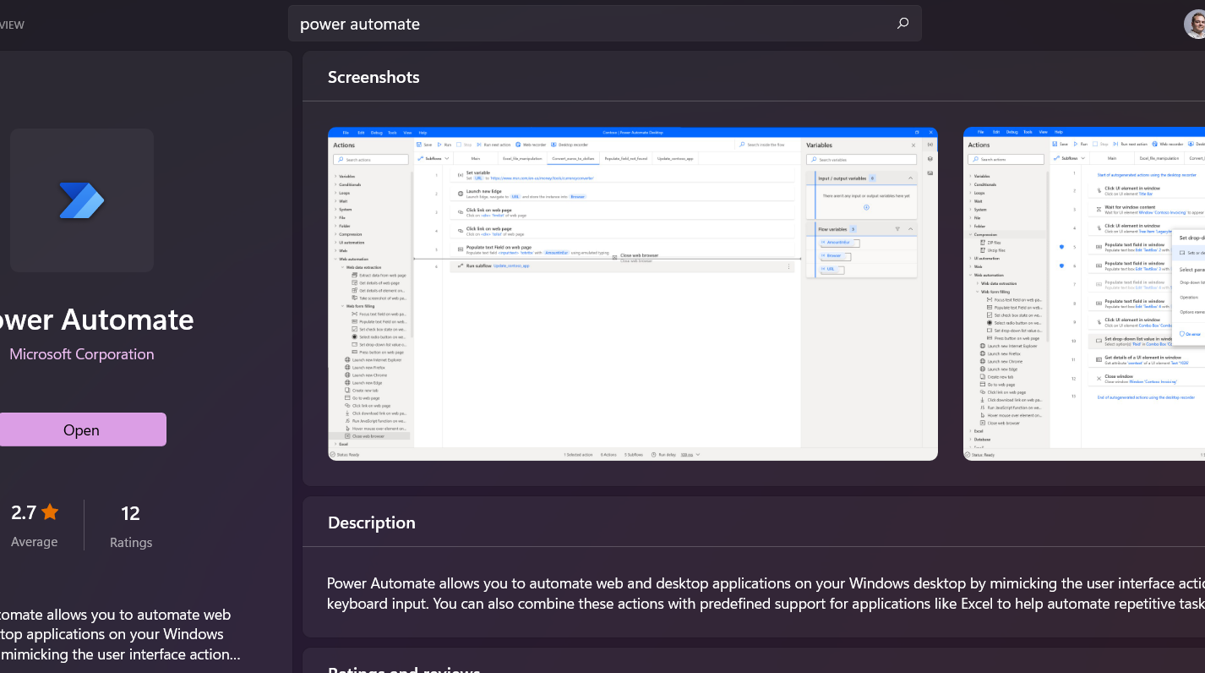
Power Automate Desktop (Windows Store)

Slide 25
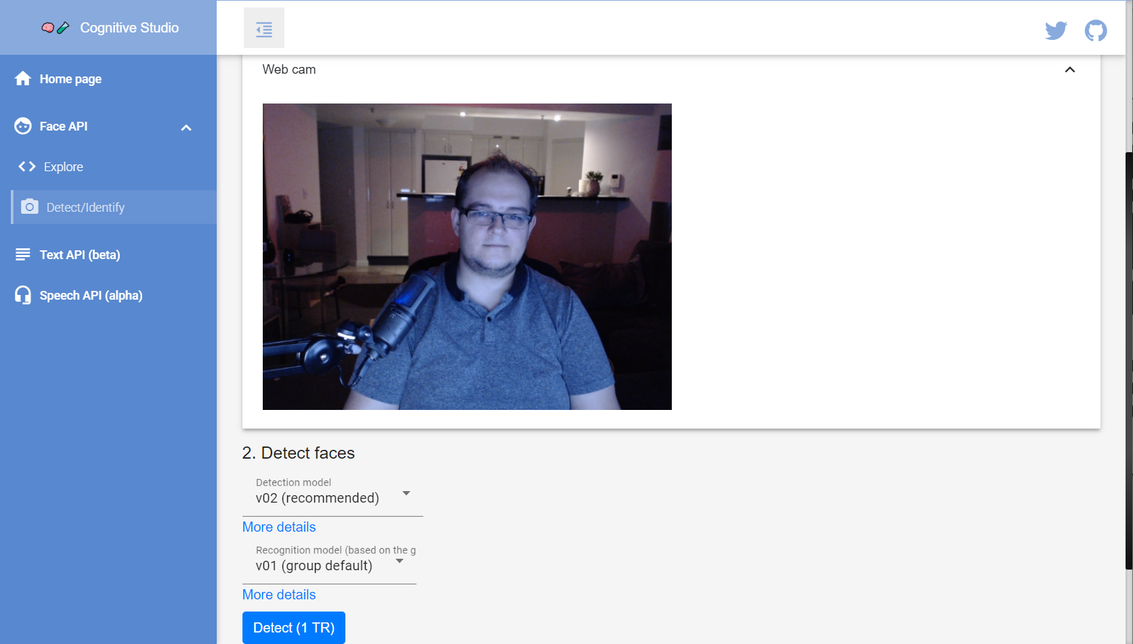

Cognitive Studio – cognitivestudio.dev

Slide 26
Additional demos
Voice to text transcription https://github.com/timleyden/speechtotextdemo
Many Cognitive Services demos by Microsoft https://github.com/Microsoft/Cognitive-Samples-IntelligentKiosk

Slide 27
Thank you! https://jkdev.me @Jernej_kavka info@ssw.com.au www.ssw.com.au Sydney | Melbourne | Brisbane | Canberra | Gold Coast
Notes:
Additional resources:
https://towardsdatascience.com/what-are-the-types-of-machine-learning-e2b9e5d1756f
https://towardsdatascience.com/types-of-machine-learning-algorithms-you-should-know-953a08248861
https://discuss.datasciencedojo.com/t/101-machine-learning-algorithms-for-data-science-data-science-blog/702

Slide 28
Resources
Cognitive Services
https://azure.microsoft.com/en-au/services/cognitive-services/
Demos
https://github.com/jernejk?tab=repositories
https://jkdev.me/tag/ai/
Cognitive Studio
https://cognitivestudio.dev/
Power Automate
https://australia.flow.microsoft.com/en-us/

Slide 29

Thank you! https://jkdev.me @Jernej_kavka info@ssw.com.au www.ssw.com.au Sydney | Melbourne | Brisbane
Notes:
Note: You should say “thank you” and then pause for 4-5 seconds… to give the audience time to applaud!
https://www.ssw.com.au/rules/do-you-finish-your-presentation-with-a-thank-you-slide

Slide 30
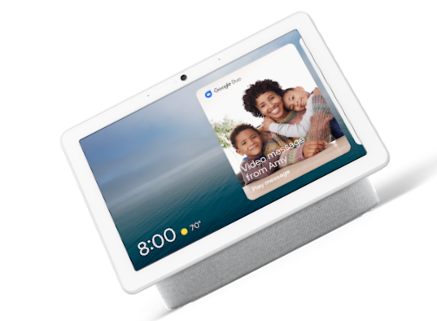
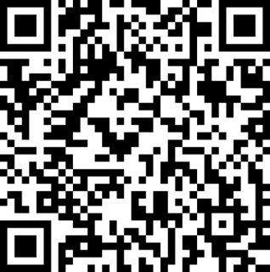
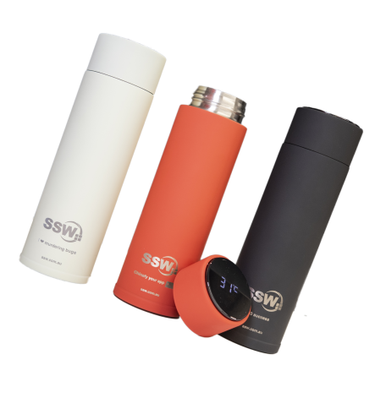
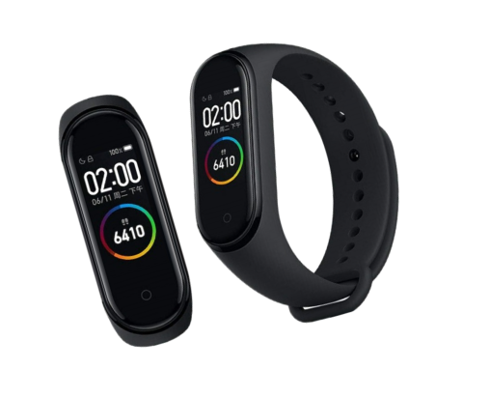
Scan the QR code below and earn
SSW Points for watching this talk!

Slide 31

Find this presentation on GitHub!
github.com/sswconsulting/presentations
Notes:
https://www.ssw.com.au/rules/do-you-keep-your-presentations-in-a-public-location
Example slides: https://github.com/Hona/BlastOffWithBlazor.Demos/raw/main/Presentation.pptx

Slide 32
Questions? info@ssw.com.au www.ssw.com.au Sydney | Melbourne | Brisbane
Notes:
Note: You should pause for applause here!
https://www.ssw.com.au/rules/do-you-finish-your-presentation-with-a-thank-you-slide

